Slide 1
Orange’s Adventure
Game Design
Spring 2018
Sun Yu

Slide 2
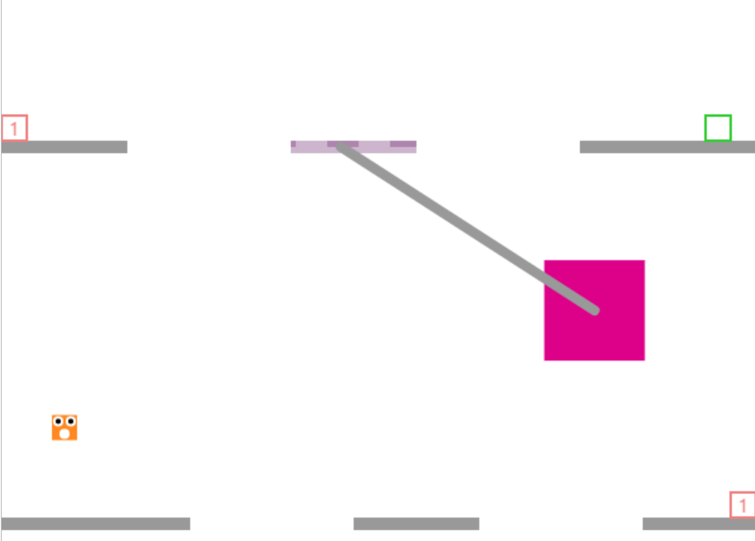
Brief Introduction
This game is a 2D game and looks like Super Mario. In this game, the main character with a big mouth, dressed with orange clothes, has big dark eyes and who can jump very high. He has a nickname “Orange”.
Next Stage Entrance
Pendulum bob
Orange
Worm hole

Slide 3
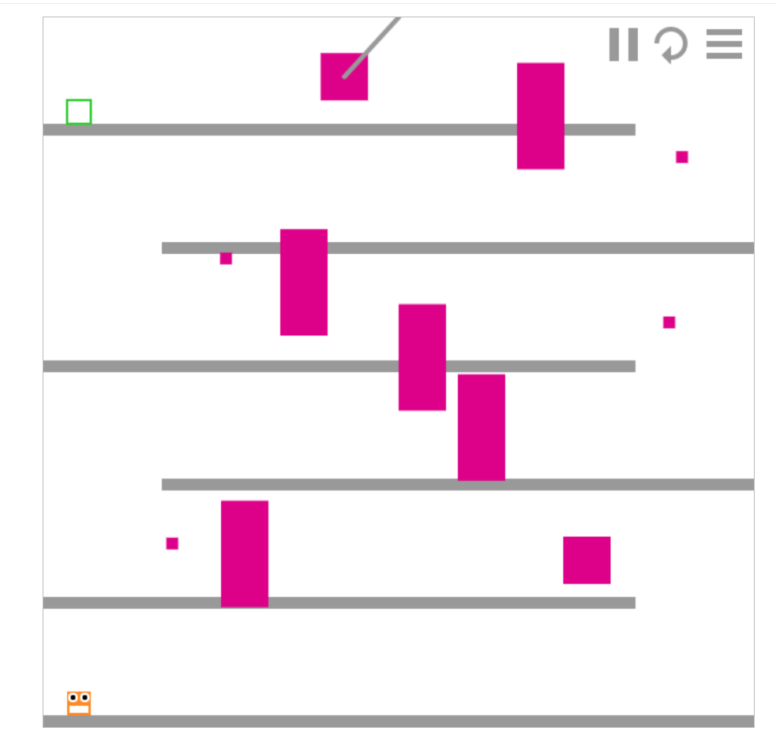
Brief Introduction
From stage 1 to stage 10, it’s easy to pass, only one or two barriers that you have to jump over, but from stage 11 to stage 20, there are 3-4 barriers in each stage, you have to be cautions about your surroundings, otherwise you will be dead , you should restart the current stage.
After stage 20, it’s much hard to you to pass every stage, the number of barriers may more than 5, you have to notice the surroundings at any time.
Circling pieces
Red Barriers

Slide 4
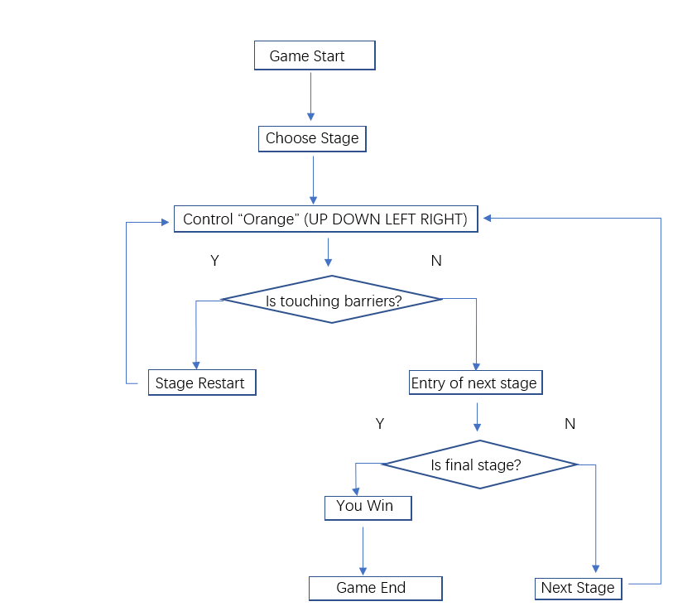
State Machine

